Slide 1

CASE APPLICATION
Write a software solution for a Digital Streaming System which allows administrators to manage the movie catalogue information about the movies, actors, movie reviews (like Netflix or Amazon Prime) and users management, While normal user can access movies, actors and able to give movie reviews, This application stores details of movies, actors, movie reviews and users.

Slide 2

User Stories
Administrator
Have default login. Can not be edit or deleted.
username: root@mail.com
password: root1234
Can add, edit and delete movies.
Movies can be deleted if 1 year older from year released.
Can add, edit and delete actors
Actors can be deleted when no movies casted.
Can approved and disapproved reviews.
Can’t put any review.
Can add, edit and delete users.
Can approved and disapprove new register users.
Can edit users privileges.

Slide 3


User Stories
Public Users
Can register (for approval)
Can login if approved
Can views and search movies
Can give rating and reviews (for approval)

Slide 4
Technologies
Front End
Back End
React - Typescript
Loopback 4
`
Redux Toolkit
Database
HTML - SCSS
MongoDB
Material UI

Slide 5

Technologies
Unit Testing
React Testing Library
Jest
Code Quality and Testing Coverage
Mocha
SonarQube

Slide 6
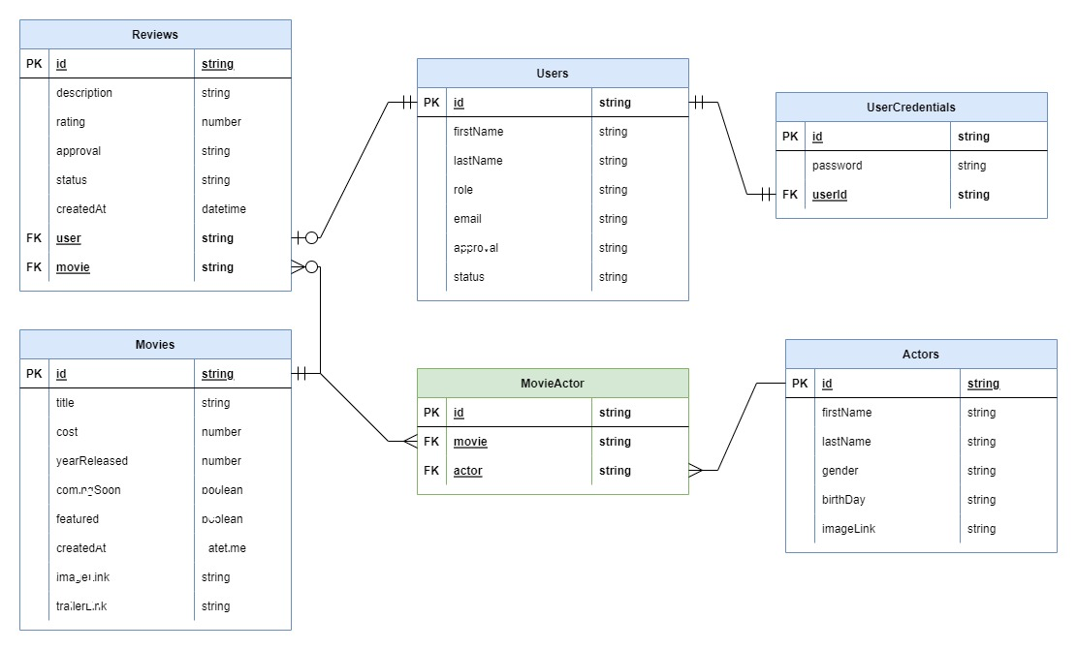
ENTITY RELATION DIAGRAM

Slide 7

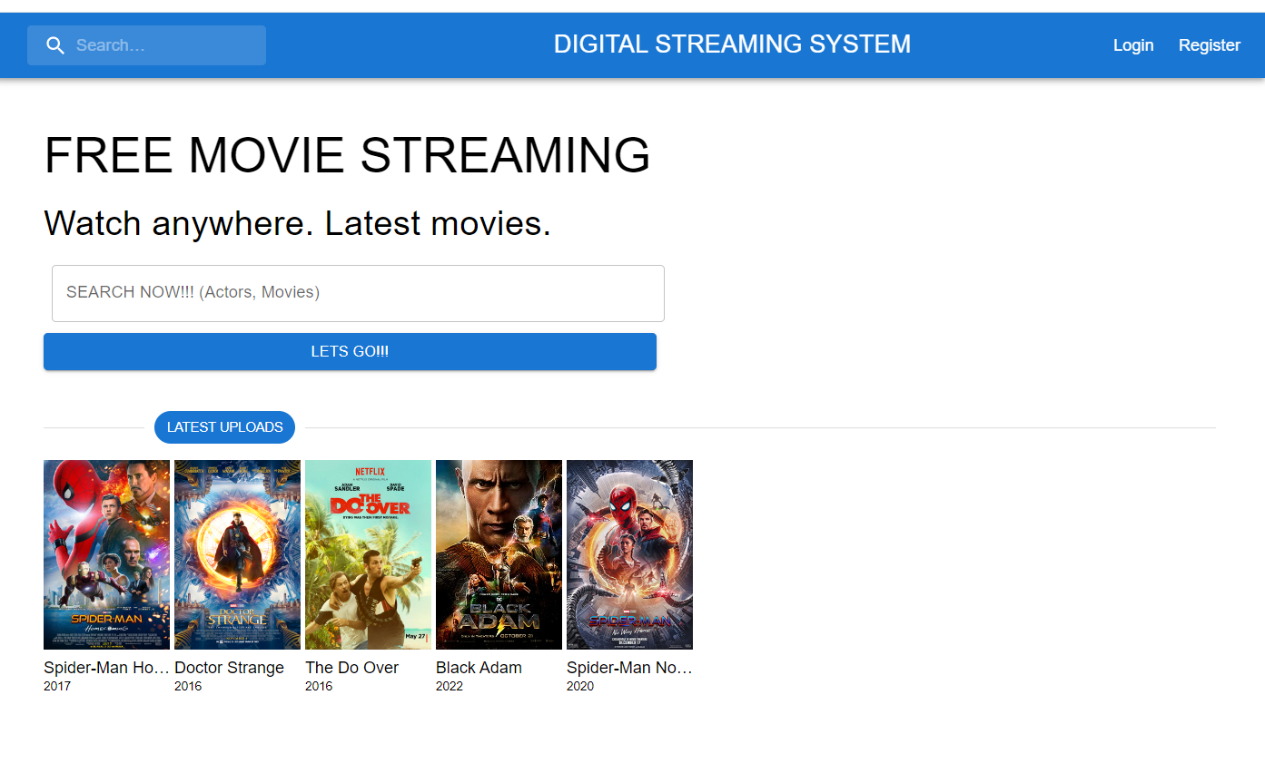





SOLUTION APPLICATION
A Digital Web Application that fans, critics, or anyone can rate and review movies.
Admin management that allows to add, update and delete movies, actors, and approved reviews.
It has registration for users who want to add rate and reviews to a movie.

Slide 8
START DEMO
Slidesgo

Slide 9
Question and Answer
Slidesgo

Slide 10
Slidesgo
Thank you ☺

